Slide 1

Managing Megaprojects: Need for a Public Sector Project Management Office (PMO)
Presented By: Dr Eng. Ben Rafemoyo

Slide 2
Presentation Outline
Background
What is a Project or Program
Major Risks and Challenges common in Megaprojects
The Role of a Project /Program Management Office
Way forward for Zimbabwe

Slide 3
Background
The requirements of public administration institutions are increasing and projects becoming progressively challenging. Managing a project is a complex activity, in particular when it involves many people working over long periods of time and many different stakeholders.
This increasing complexity requires management practices and tools that assure an efficient use of resources. In this context, a Project Management Office (PMO) can be of great value.
By Elsevier B.V.

Slide 4
Background
At the strategic level, the role of the PMO is to guarantee that projects are aligned with the strategic objectives of the organization, so that projects assumed are consistent with the business long-term objectives (project and team members have a direct relation to the organization's strategic operating plans.
Implementing project management across an organization, both as a set of skills and as an integral component of an enterprise, is a significant endeavor that involves multiple coordinated activities and efforts.

Slide 5
What is a Project or is it a Program?
The difference between projects and programs has been ignored or confused by many people for a long time. A project is chartered to create a specified “deliverable” as efficiently as possible
On the other hand, programs focus on the coordination of a number of related projects and other activities, over time, to deliver benefits to the organization or communities.
Unfortunately, from the very beginnings of modern project management, the terms have often been used interchangeably
(Project Management Institute [PMI], 2008a).

Slide 6
The Four Dimensions of a Project or Program
Every project or program has four basic dimensions:
Its inherent size, usually measured in terms of value;
The degree of technical difficulty in creating the output;
The complexity of the relationships (“small p” politics) with the stakeholders; and
The degree of uncertainty involved in the work.

Slide 7
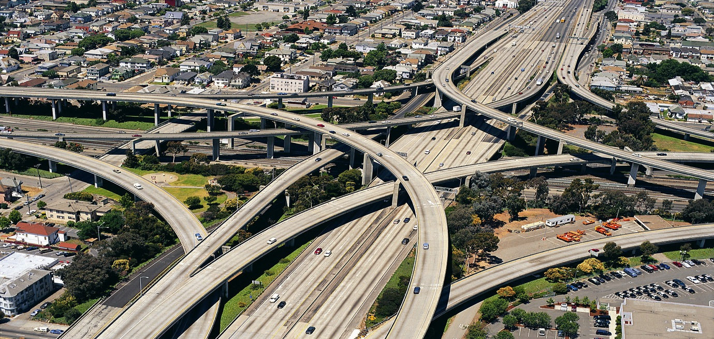
This increasing complexity requires management practices and tools that assure an efficient use of resources. In this context, a Project Management Office (PMO) can be of great value.

Slide 8
Major Risks and Challenges common in Megaprojects
Complicated high-tech projects and programs are inherently more difficult to manage than technically simple projects and programs. The nature of the technical difficulties and the degree of certainty largely depend on how well-understood the work is.
A key challenge facing project and program management professionals is managing the expectation of senior managers. Unrealistic expectations are unlikely to be realized, and creating realistic expectations in senior management thinking requires a sustained process of education and communication.

Slide 9
Major Risks and Challenges common in Megaprojects
Realistic expectations of a project should include reasonably high levels of certainty in terms of time, cost, scope, risk, and quality. Importantly, the level of certainty should progressively increase as the project moves through its life cycle.
The skill of a project manager lies in identifying ambiguity and uncertainty and then seeking to remove or resolve the causes. The more uncertain the work, the more likely program management approaches will deliver better outcomes for the organization.

Slide 10
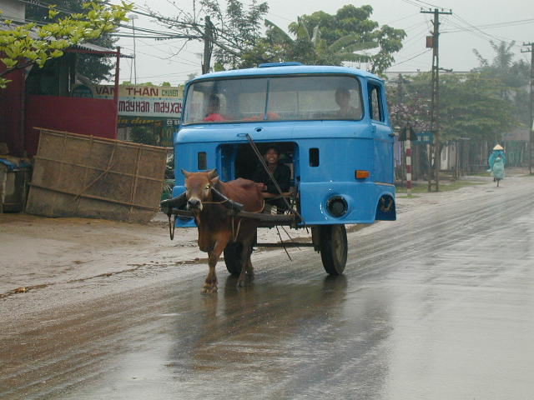
Common Project Risks – End Product Not Matching the set Objective

Slide 11
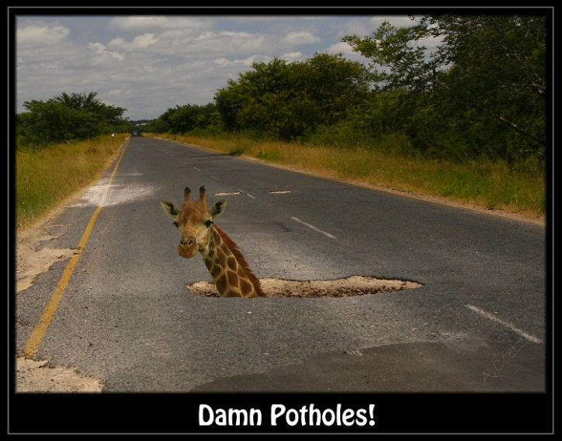
Common Project Risks – End Product Not Matching the set Objective

Slide 12
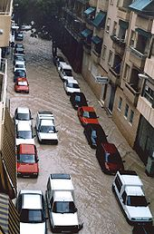
Common Project Risks – End Product Not Matching the set Objective

Slide 13
The Role of a Project /Program Management Office
Projects are strategic in nature, so are the demands on a project manager. Organizational success, achievement of business goals is directly linked to the successful completion of projects on time, within budget and with quality.
The project manager has to cater to the needs of the project, the organization (organizations), industry, professional discipline and across disciplines. Performing integration is the key role of the project manager.
Performing integration comprises of the ‘Plan, Do, Check and Act’ of integrating the efforts and work of all to achieve the project goals.

Slide 14
The Role of a Project /Program Management Office
The most important role of a project manager is that of an integrator. Not only should she/he get this but he/she should know how to communicate this to others around him/her both inside teams and outside. He/She is not just a scheduler, cost manager, quality or risk manager.
He/she is the orchestra leader. He is the integrator of all the moving parts in the project. She is there to make sure that everyone does what they are supposed to do.
To connect all these people and parts and moving objects and at the same time to make sure that a good communication process is in place so that everyone knows what they need to know, when they need to know it and in a format that they can easily consume.

Slide 15
The Role of a Project /Program Management Office
If the violins go off on a tangent, the orchestra leader needs to deal with this change and make sure that the show goes on with everyone moving together.
When a contractor doesn’t deliver on time, the project manager needs to make sure that all other parts of the puzzle are aware and can adjust.
From major stakeholders to the people in the trenches doing the work, the project manager sees everyone and everything at all times and makes sure that with all the bumps and curves and problems, the project will get delivered as best can be and as promised.

Slide 16
The Role of a Project /Program Management Office
The project manager must have a combination of skills including an ability to ask penetrating questions, detect unstated assumptions and resolve conflicts, as well as more general management skills.
Key among a project manager's duties is the recognition that risk directly impacts the likelihood of success and that this risk must be both formally and informally measured throughout the lifetime of a project.
Risks arise from uncertainty, and the successful project manager is the one who focuses on this as their primary concern. Most of the issues that impact a project result in one way or another from risk.

Slide 17
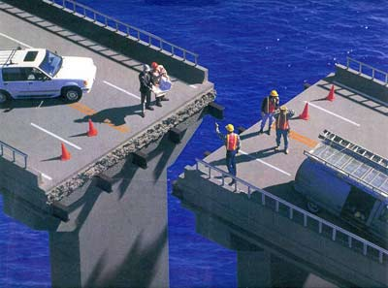
A project manager is a person who has the overall responsibility for the successful initiation, planning, design, execution, monitoring, controlling and closure of a project. Construction, petrochemical, architecture, information technology and many different industries that produce products and services use this job title.

Slide 18

Megaprojects can be seen as the wild beasts in the project world, they are hard to tame, known for their complexity, vast size, expensive cost, and long time frame. These projects bring big changes in the geography of countries and life of people. Some of these megaprojects become landmarks for a country and bring significant prosperity, but some become unforgettable catastrophes.

Slide 19
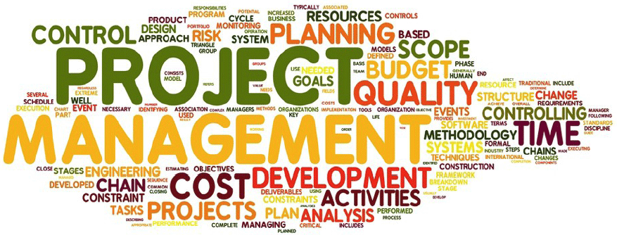
Need for a Public Sector Project Management Office (PMO)

Slide 20
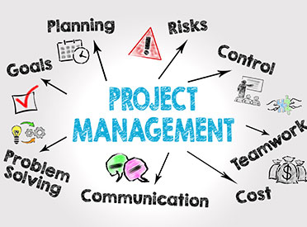
Need for a Public Sector Project Management Office (PMO)

Slide 21

Way forward for Zimbabwe

Slide 22

Way forward for Zimbabwe

Slide 23
Way forward for Zimbabwe
There is a clarion call for the Zimbabwe Government to take advantage of the available skills in the country in the field of Project Management to provide expert oversight on the various megaprojects being implemented.
Governments of a number of developed and emerging economies have gone to the extent of mandating enabling policies geared towards the acceleration of project management talent development in the public and private sectors in order to spur economic growth support.
It does not make sense to invest huge sums of money to implement public sector megaprojects which fail to reach finality within the budget, timelines and meeting quality standards by trying to serve on the cost of employing the right Project Management Skills – “penny wise pound foolish”

Slide 24
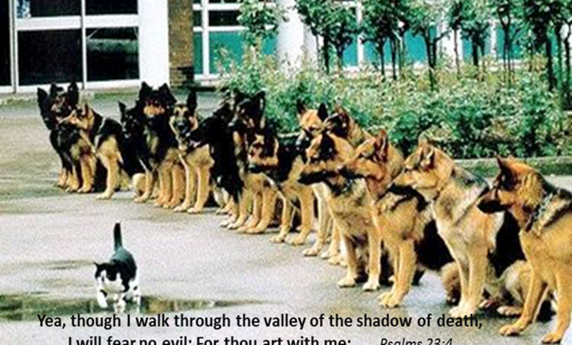
Concluding Remarks

Slide 25
Thank you For listing
Dr eng. Ben rafemoyo
Chief executive officer
Engineering council of zimbabwe
  benrafemoyo@ecz.co.zw

